Slide 1
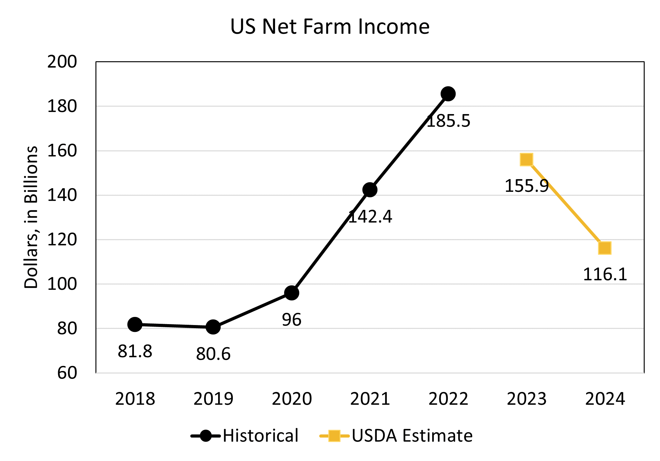

Slide 3
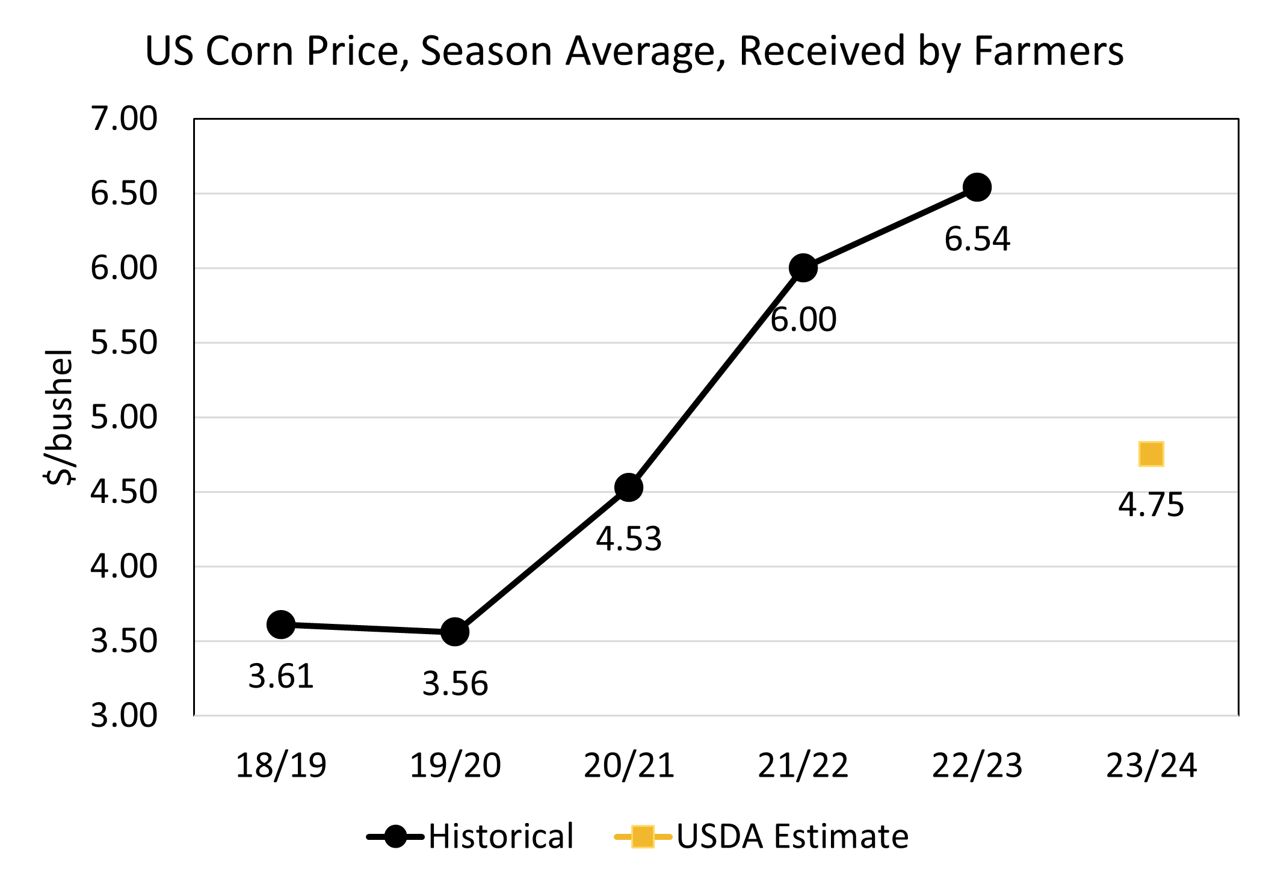

Slide 4
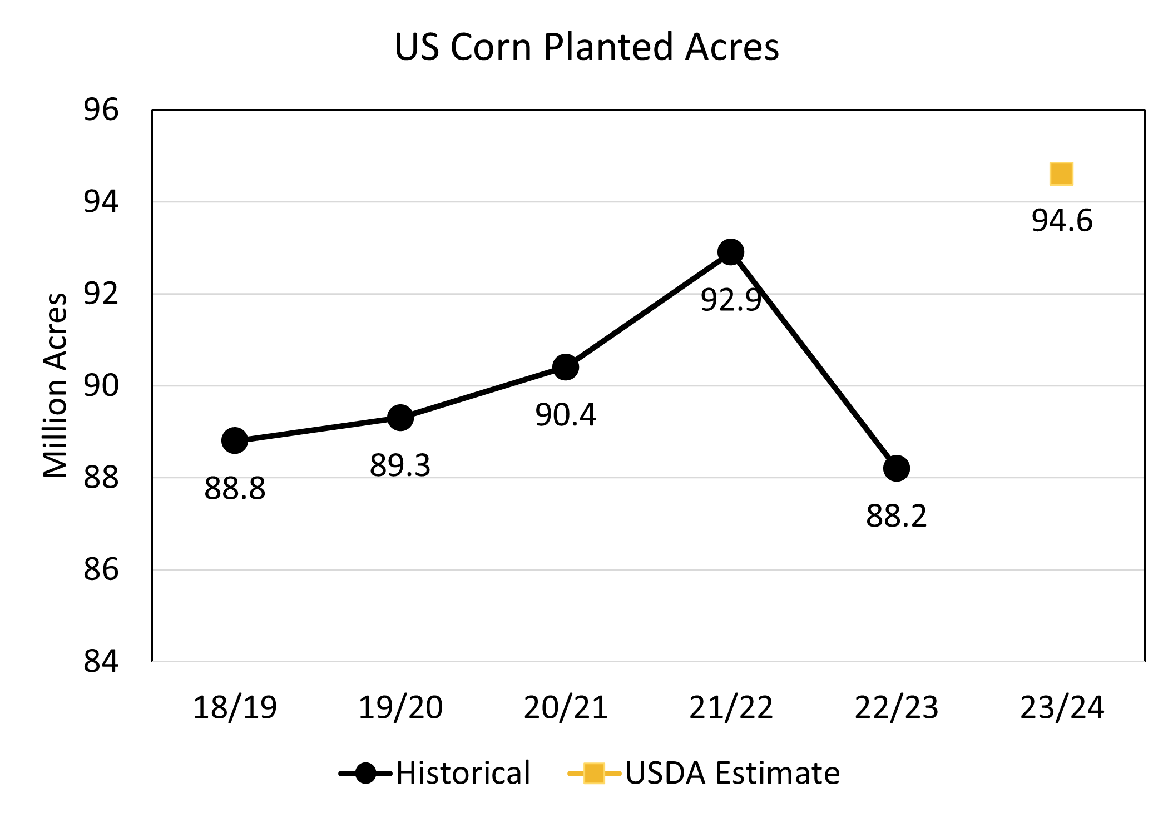

Slide 5
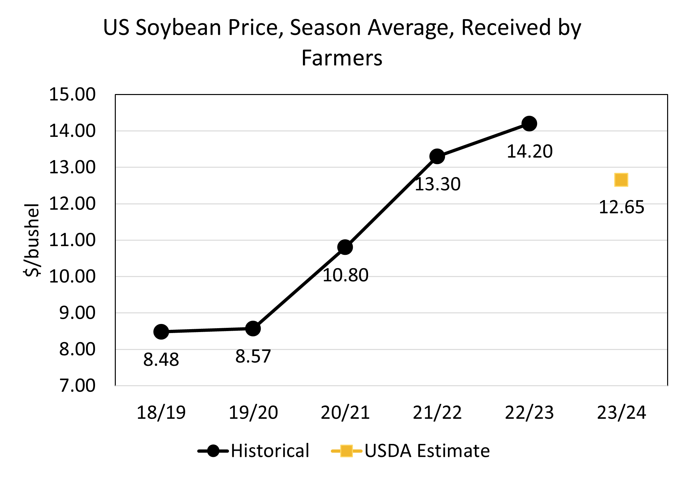

Slide 6
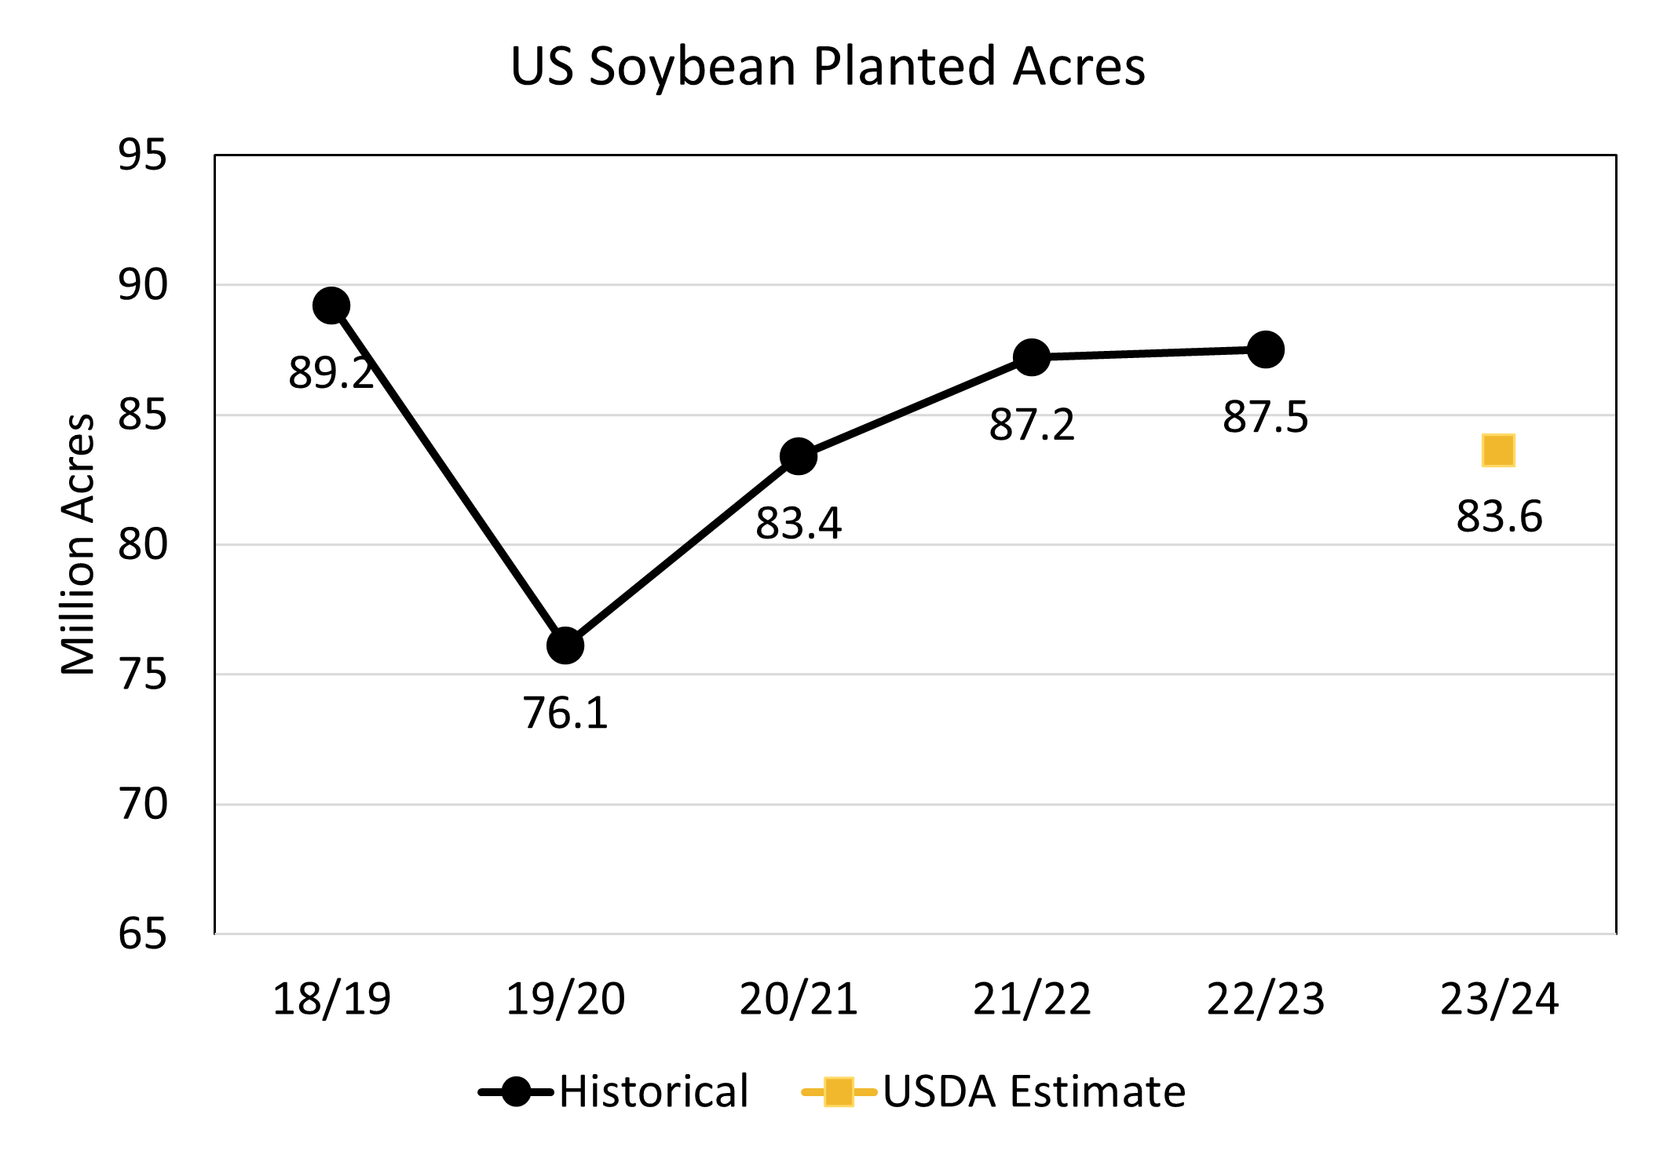

Slide 7
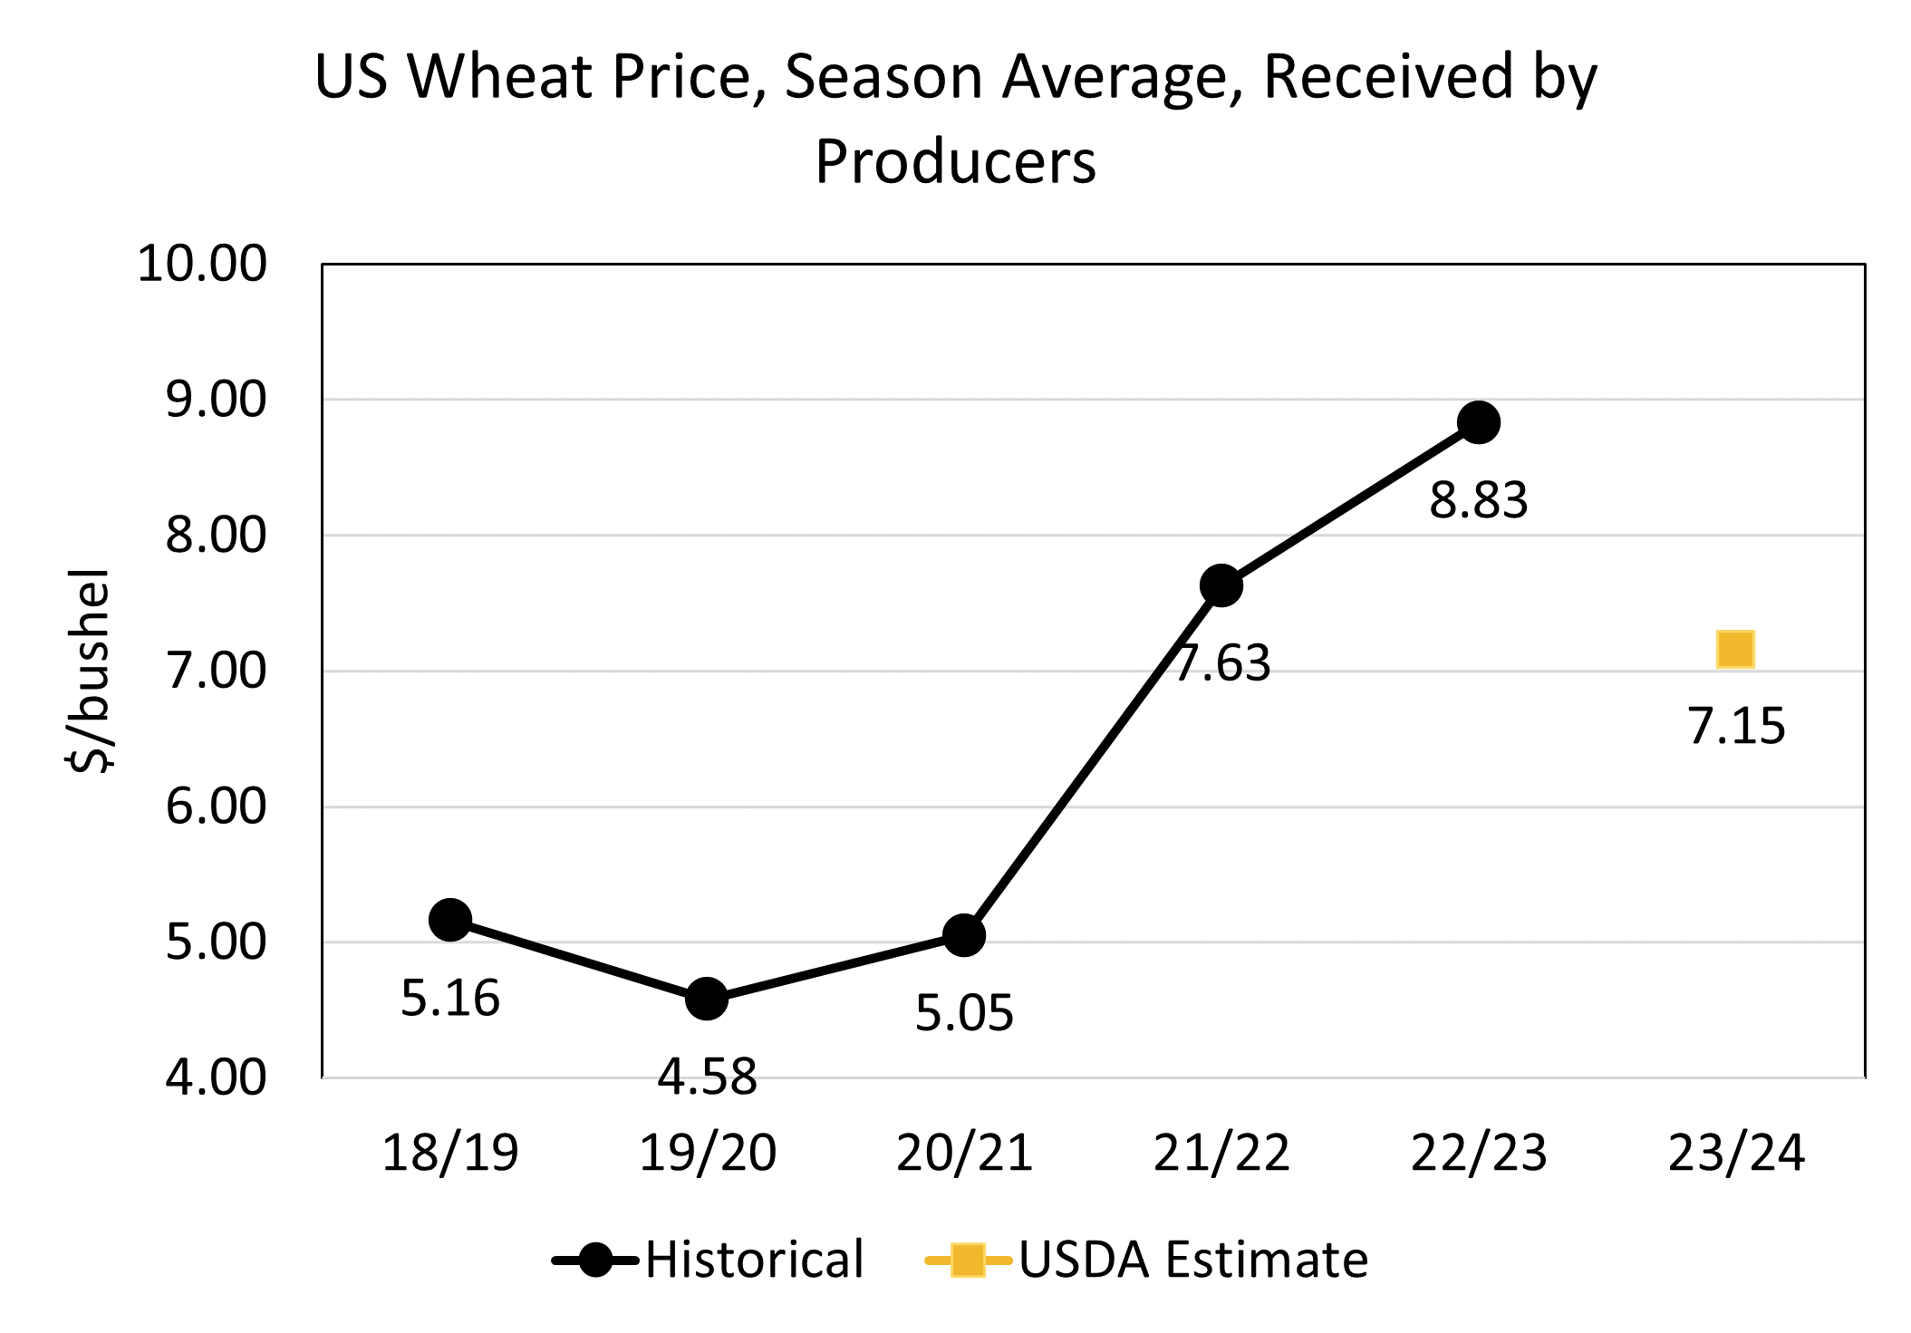

Slide 8
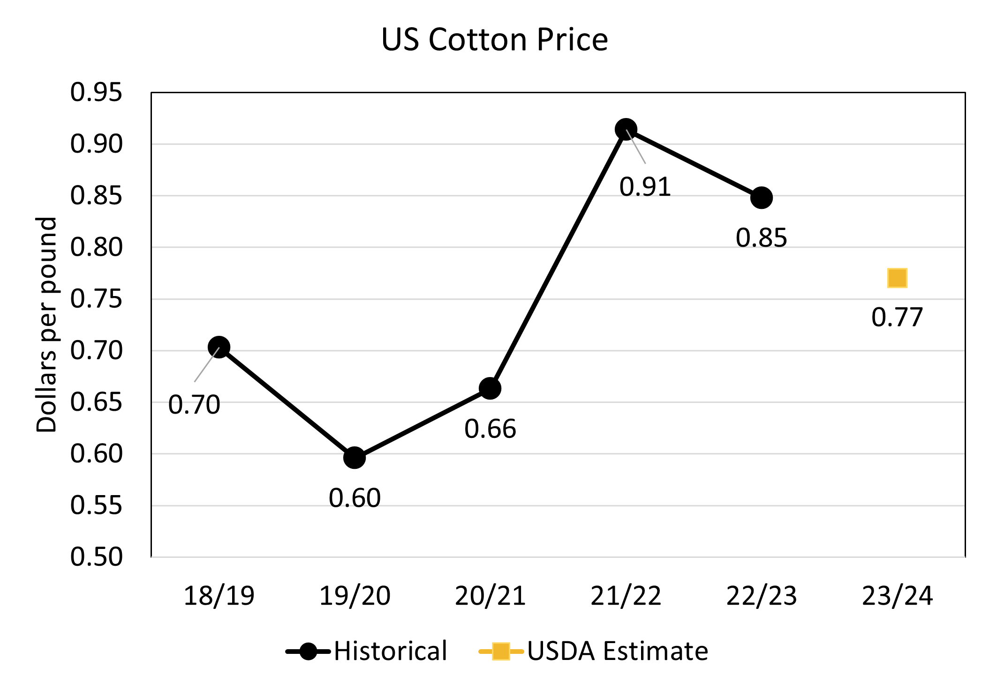

Slide 9
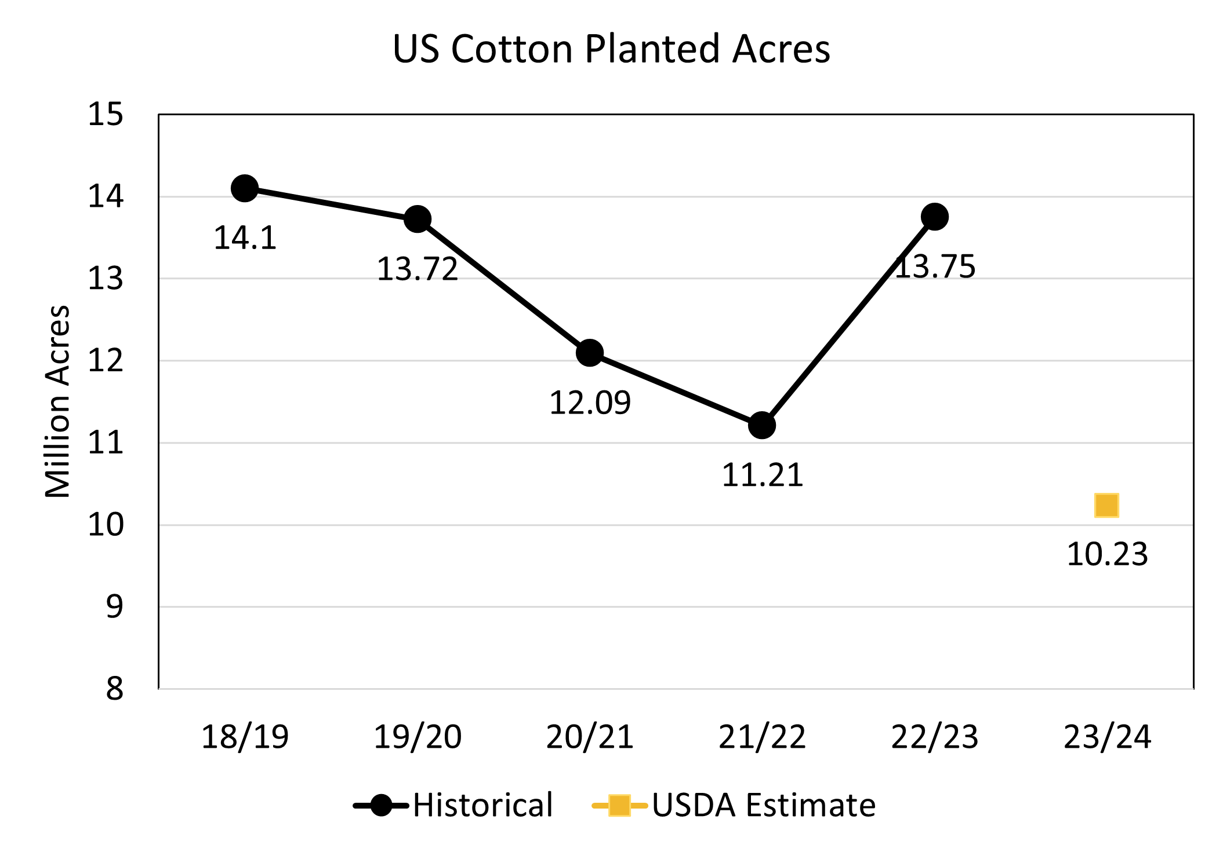

Slide 10
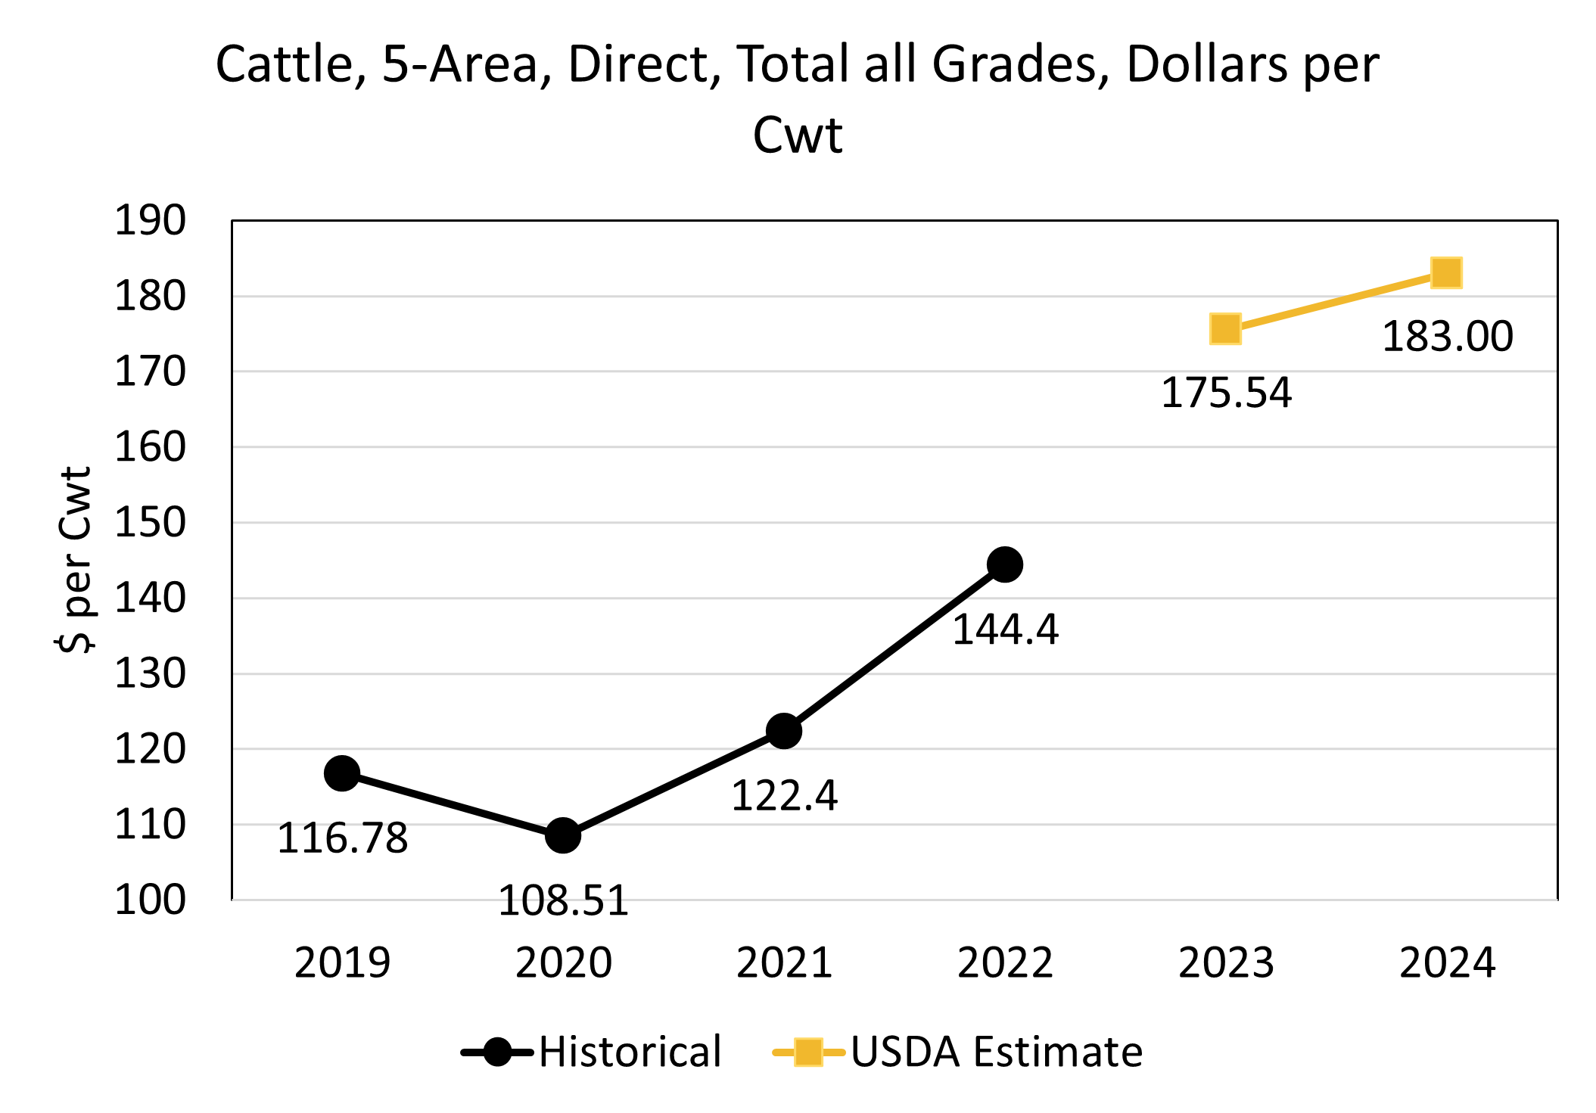

Slide 11
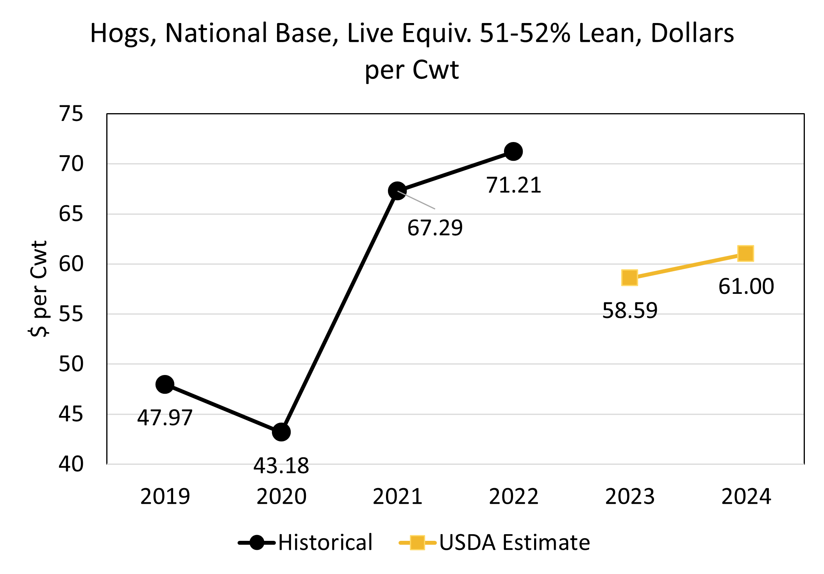

Slide 12
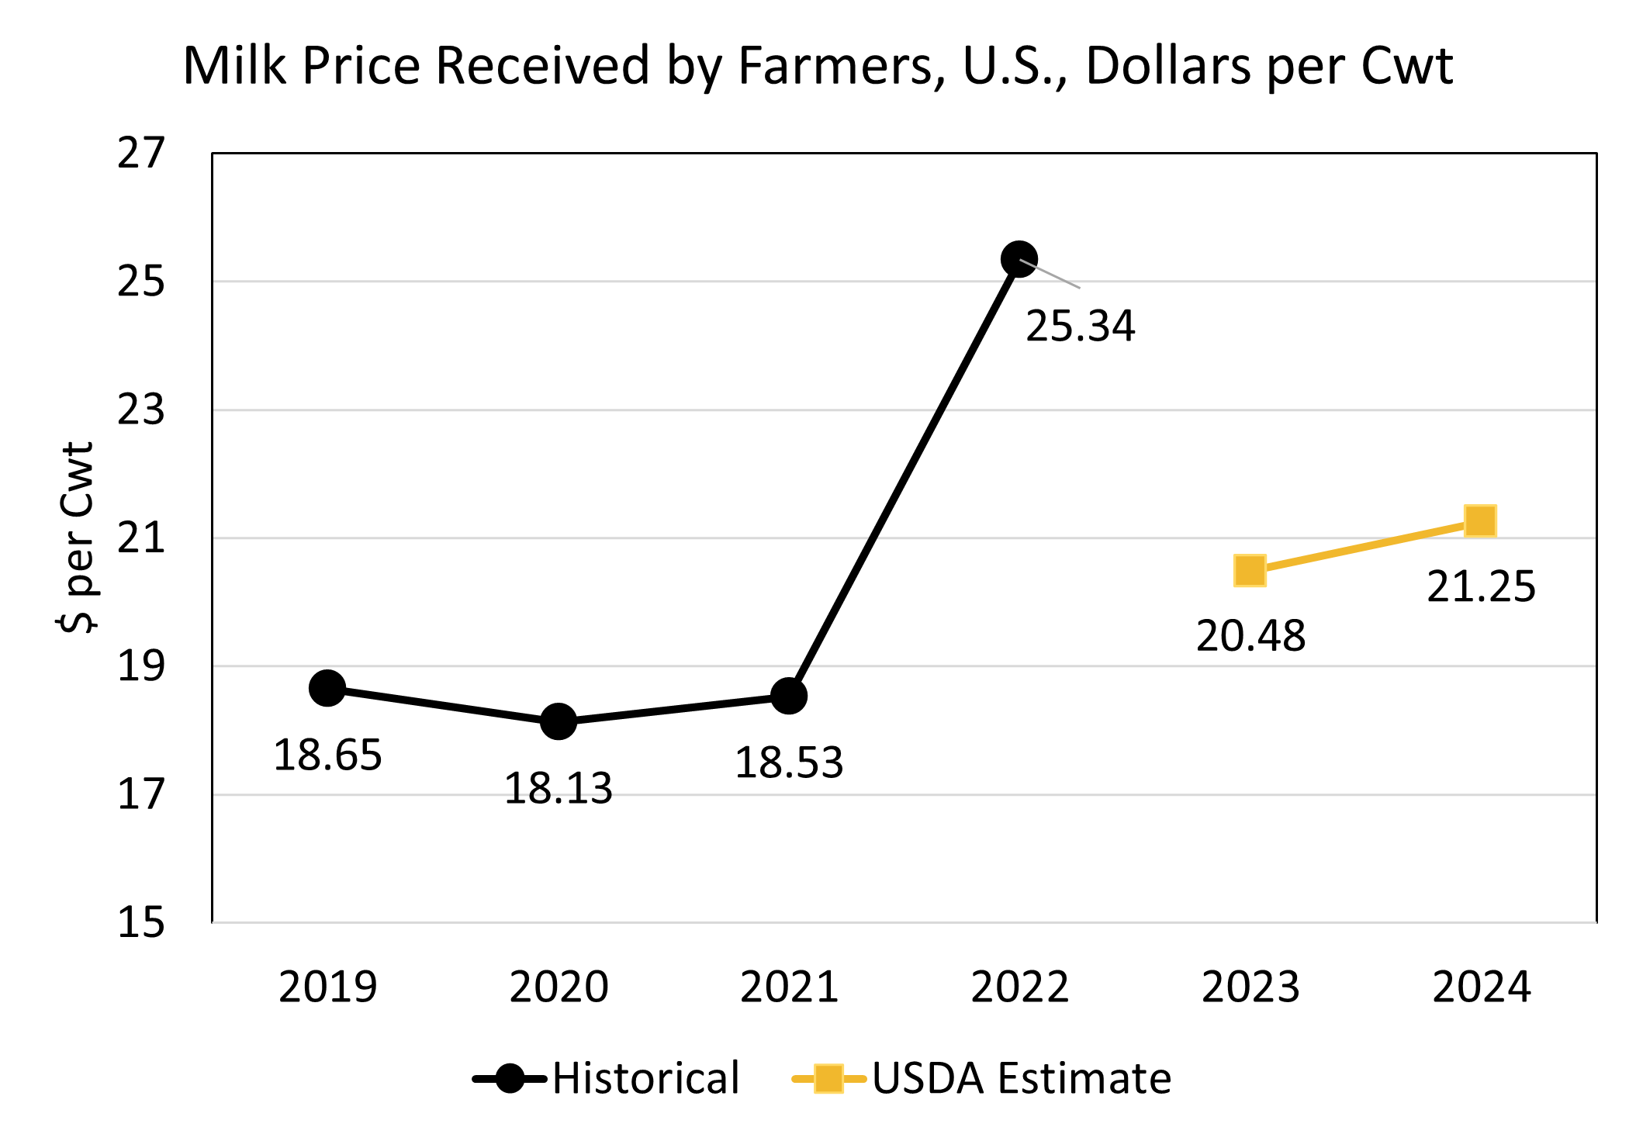

Slide 15
What are the two most important factors driving agriculture's economic health today, and in 12 months?
  Declining prices for many commodities, and the mixed impact of higher cattle and hog prices.
  Higher cost of production, including input costs, interest rates and land rental rates.
  Concerns regarding exports and global economic growth, as well as regulatory and policy uncertainty.
What factor(s) will impact crop prices in the next 6 months?
  Domestic and global weather impacts on planting and the growing season.
  Planting intentions and production prospects for the U.S.
  Global impacts related to export demand, competitor production, economic health and conflicts; specific mentions made of South American crops, Hamas conflict in the Suez Canal and Chinese demand.
  Domestic demand strength and general economic health.
What factor(s) will impact livestock prices in the next 6 months?
  Consumer confidence and demand driven by economic growth.
  Supply conditions remain tight for cattle as herd rebuilding conditions.
  Potential drought conditions impacting forage recovery, among other things.
What factors are important to your selection of corn versus soybeans as offering the best return potential?
  More room in soybean returns compared to corn, giving it the profitability edge as margins appear tighter for corn.
  Soybeans were also favored due to lower production costs, domestic demand, favorable crop prices and less downside risk compared to the corn market.
  Respondents who favored corn mentioned capacity at harvest, more opportunity to out-yield than soybeans, and lower fertilizer prices anticipated this spring.
How will farmers adjust risk management strategies with this year's lower spring crop insurance prices? (For example, purchase ECO or SCO, higher or lower coverage levels, change to yield insurance, change acreage decisions, no change, etc.)
  Sentiments varied by respondents’ geographic region, highlighting the diversity of risk management strategies.
  Some respondents anticipated similar or lower coverage levels of crop insurance compared to previous years, although a few respondents noted the possibility of an uptick in purchases of products like ECO, SCO and MP enrollment.
  Mention was made about potential acreage shifts due to market signals.
China recently announced it will sharply expand its budget to stockpile grains and edible oils. Reports say this initiative is aimed to improve food security, but do you believe there are other motives?
  Sentiment was mixed among respondents, with some strongly believing that there are other motives at play… key themes included:
    Helping internal prices for Chinese farmers and supporting domestic production
    Preparing for the possibility of increased conflict with the U.S.
    China’s growing concern about a change in U.S. administration
  Respondents who indicated that China had no other motives with its announcement made mention of the nation attempting to build stocks amid low prices, as well as food security, in their explanations.

